Slide 1
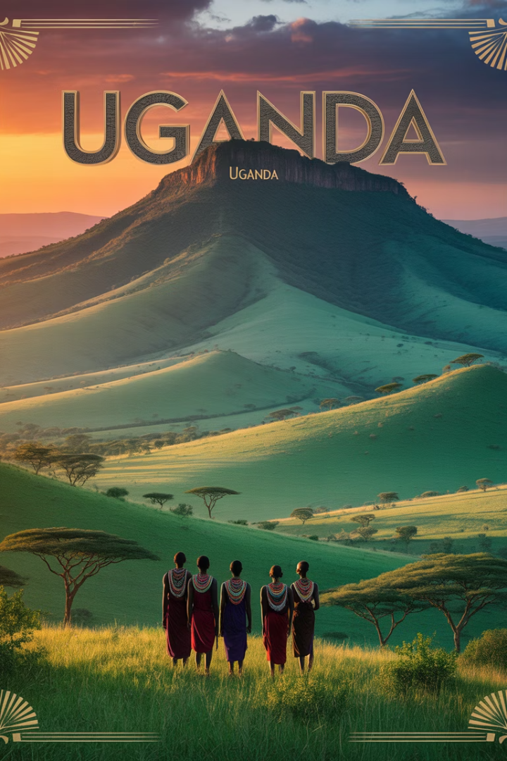
My Experience at the International Bootcamp Uganda
A journey from Belgium to East Africa that transformed my perspective and connected me with extraordinary people and opportunities.

Slide 2
About Me & the Group
Who I Am
Our Team
Our Purpose
I'm a student pursuing my degree in Belgium. This was my chance to represent our university internationally.
We were 10 junior coaches from Thomas More University. Each of us brought unique perspectives to Uganda.
We embodied our university's values abroad. The bootcamp was our platform to make a global impact.

Slide 3
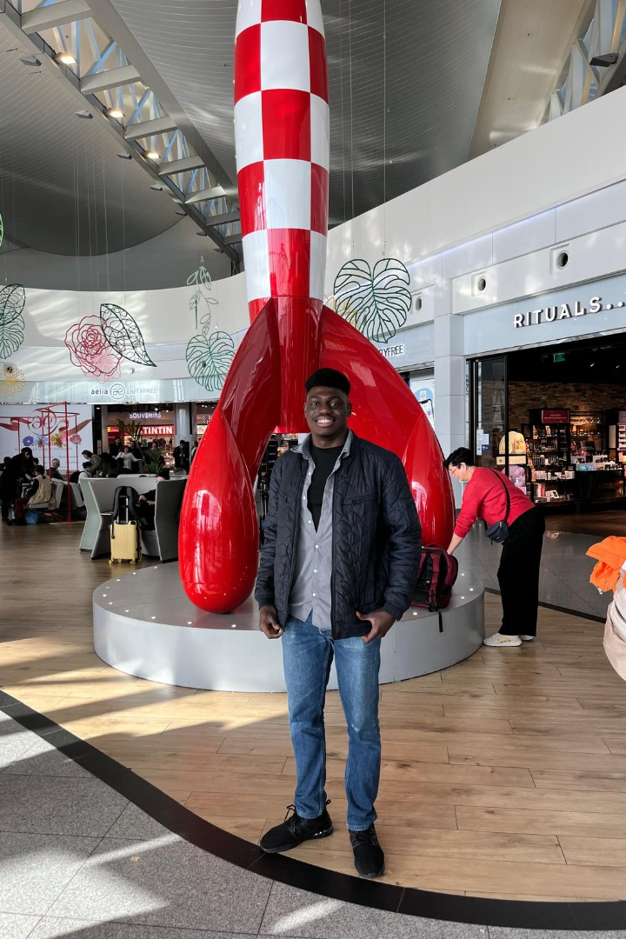



Why This Trip Mattered
New Horizons
Connection Opportunities
My first journey outside Nigeria. East Africa opened an entirely new world to me.
A chance to build relationships across continents. Every conversation promised growth.
Personal Development
I felt excitement mixed with curiosity. The unknown beckoned with possibility.

Slide 4
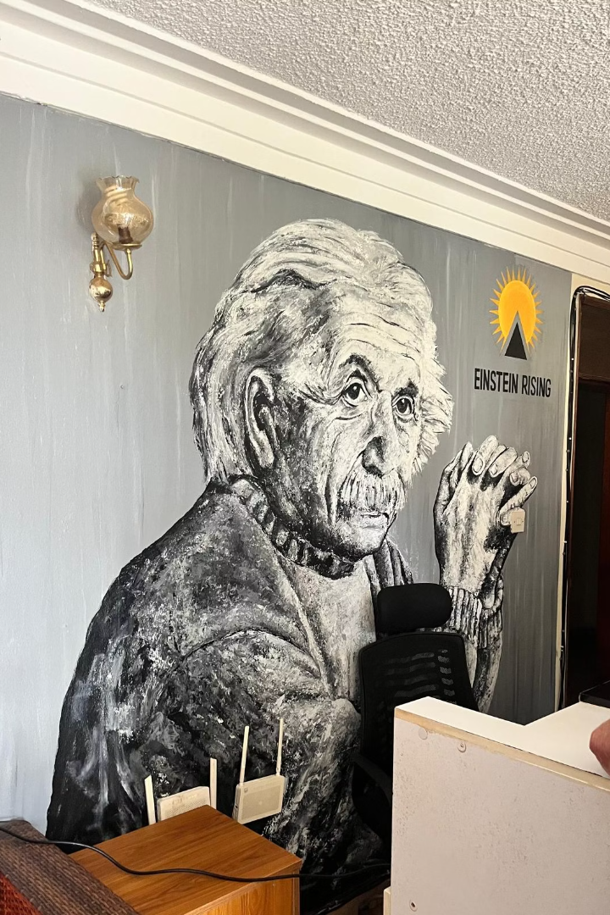




The Bootcamp Setup
Duration
One intensive week in Uganda. Every day packed with learning.
Participants
10 Junior Coaches and 11 Senior Coaches. A perfect blend of experience levels.
Core Event
Three days coaching startups. We helped entrepreneurs refine their visions.
Additional Activities
Company visits and cultural events. We immersed ourselves in Ugandan life.

Slide 5
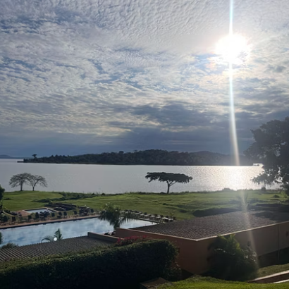
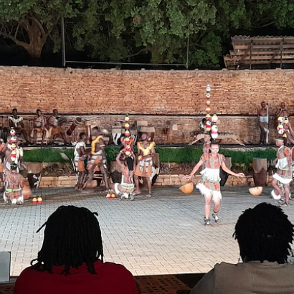
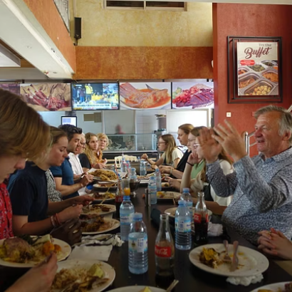
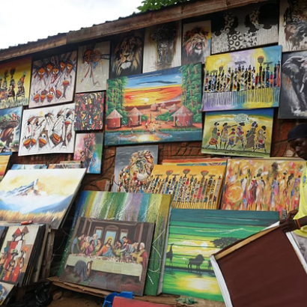
Living & Exploring
Our beautiful resort became our sanctuary. Between coaching sessions, we explored Uganda's rich culture and vibrant business landscape.

Slide 6
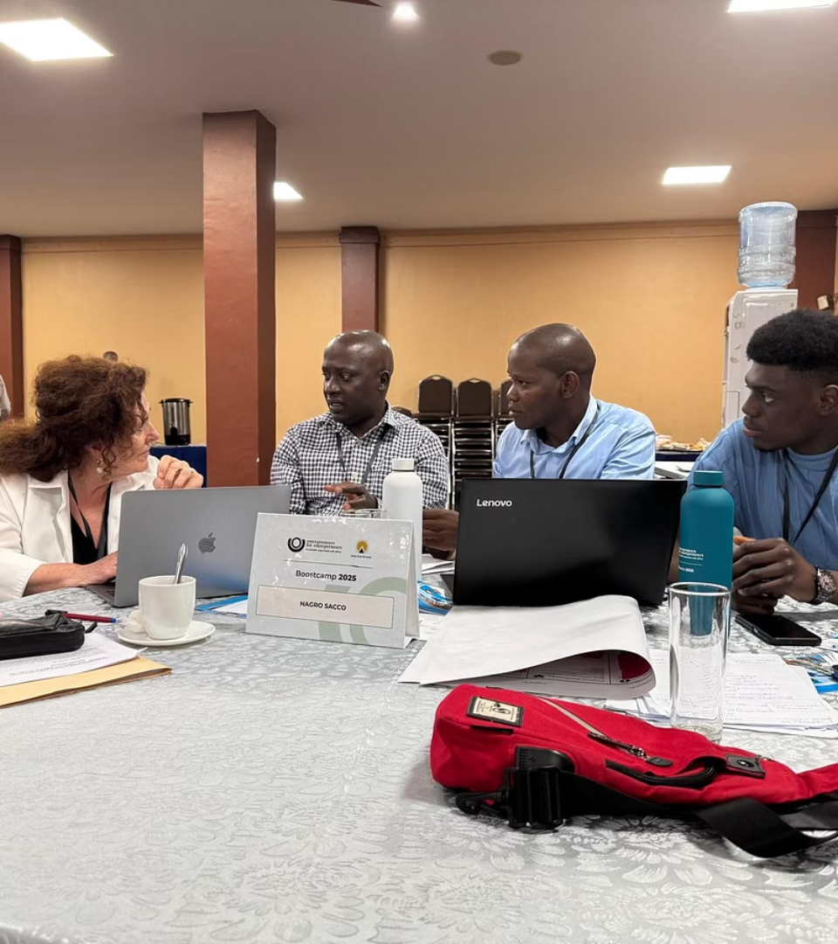
The Bootcamp Experience
Initial Meetings
We met entrepreneurs with raw ideas. Their passion was immediately contagious.
Coaching Sessions
Over three days, we refined business models. Every team made remarkable progress.
Final Pitches
Entrepreneurs presented transformed ideas. Their confidence had visibly grown.
The entrepreneurs' openness and eagerness to learn was inspiring. We made a real impact while gaining invaluable experience ourselves.

Slide 7








People & Connections
Instant Bonds
Student Connections
We created an incredible community in just one week. Laughter brought us together daily.
Fellow students were funny and warm. Shared experiences created lasting friendships.
Ugandan Hospitality
Mentor Relationships
Local people welcomed us completely. Their kindness made Uganda feel like home.
Senior coaches became true mentors. Their guidance extended beyond the program.

Slide 8
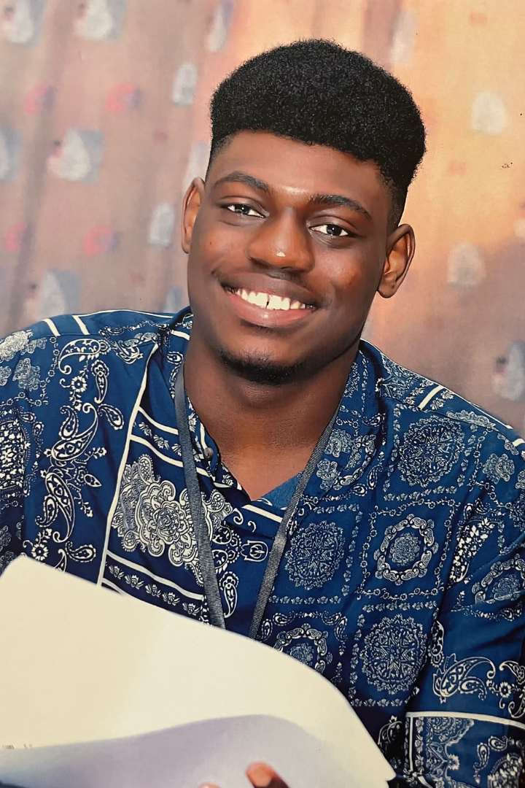
Goals Set vs Achieved
Networking
✅ Connected with professionals and fellow students from across continents. These relationships continue today.
Social Entrepreneurship
✅ Visited thriving social enterprises. Learned how business can create meaningful community impact.
Intercultural Communication
✅ Engaged in deep conversations across cultural boundaries. Found common ground in our differences.
Unexpected Gains
➕ Developed newfound confidence. Gained perspective on global issues. Created lifelong memories.

Slide 9








Key Takeaways
Self-Discovery
You grow when stepping outside your comfort zone
Human Connection
Meaningful friendships can form in just days
African Potential
Collaboration unlocks incredible possibilities
Mindset Transformation
Travel fundamentally changes how you see the world

Slide 10
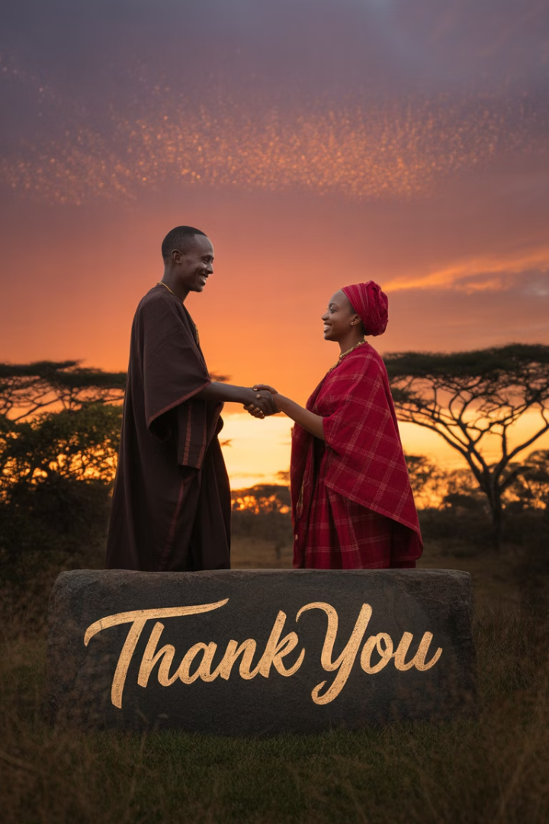
Thank You
Travel isn't always about the destination—sometimes, it's about discovering yourself.
I'm grateful to Thomas More University, our coaches, the Ugandan entrepreneurs, and my fellow students for this life-changing experience.
Questions? I'd love to share more about my journey!

